Slide 1
Informed search algorithms
This lecture topic
Chapter 3.3

Slide 2
Outline
Review limitations of uninformed search methods
Informed (or heuristic) search uses
problem-specific heuristics to improve efficiency
  Best-first, A* (and if needed for memory limits, RBFS, SMA*)
  Techniques for generating heuristics
  A* is optimal with admissible (tree)/consistent (graph) heuristics
  A* is quick and easy to code, and often works *very* well
Heuristics
  A structured way to add “smarts” to your solution
  Provide *significant* speed-ups in practice
  Still have worst-case exponential time complexity
In AI, “NP-Complete” means “Formally interesting”

Slide 3

Limitations of uninformed search
Search Space Size makes search tedious
  Combinatorial Explosion
For example, 8-puzzle
  Avg. solution cost is about 22 steps
  branching factor ~ 3
  Exhaustive search to depth 22:
    3.1 x 10¹⁰ states
  E.g., d=12, IDS expands 3.6 million states on average
  [24 puzzle has 10²⁴ states (much worse)]

Slide 4

Recall tree search…

Slide 5

Recall tree search…
This “strategy” is what differentiates different search algorithms

Slide 6
Heuristic search
Idea: use an evaluation function f(n) for each node
and a heuristic function h(n) for each node
  g(n) = known path cost so far to node n.
  h(n) = estimate of (optimal) cost to goal from node n.
  f(n) = g(n)+h(n) = estimate of total cost to goal through node n.
  f(n) provides an estimate for the total cost:
  Expand the node n with smallest f(n).
Implementation:
Order the nodes in frontier by increasing estimated cost.
Evaluation function is an estimate of node quality
  More accurate name for “best first” search would be “seemingly best-first search”
Search efficiency depends on heuristic quality!
  The better your heuristic, the faster your search!

Slide 7
Heuristic function
Heuristic:
  Definition: a commonsense rule (or set of rules) intended to increase the probability of solving some problem
  Same linguistic root as “Eureka” = “I have found it”
  “using rules of thumb to find answers”
Heuristic function h(n)
  Estimate of (optimal) remaining cost from n to goal
  Defined using only the state of node n
  h(n) = 0 if n is a goal node
  Example: straight line distance from n to Bucharest
    Note that this is not the true state-space distance
    It is an estimate – actual state-space distance can be higher
  Provides problem-specific knowledge to the search algorithm

Slide 8
Heuristic functions for 8-puzzle
8-puzzle
  Avg. solution cost is about 22 steps
  branching factor ~ 3
  Exhaustive search to depth 22:
    3.1 x 10¹⁰ states.
  A good heuristic function can reduce the search process.
Two commonly used heuristics
  h₁ = the number of misplaced tiles
    h₁(s)=8
  h₂ = the sum of the distances of the tiles from their goal positions (Manhattan distance).
    h₂(s)=3+1+2+2+2+3+3+2=18

Slide 9

Romania with straight-line dist.

Slide 10
Relationship of Search Algorithms
g(n) = known cost so far to reach n
h(n) = estimated (optimal) cost from n to goal
f(n) = g(n) + h(n)
= estimated (optimal) total cost of path through n to goal
Uniform Cost search sorts frontier by g(n)
Greedy Best First search sorts frontier by h(n)
A* search sorts frontier by f(n)
  Optimal for admissible/consistent heuristics
  Generally the preferred heuristic search
Memory-efficient versions of A* are available
  RBFS, SMA*

Slide 11
Greedy best-first search
(often called just “best-first”)
h(n) = estimate of cost from n to goal
  e.g., h(n) = straight-line distance from n to Bucharest
Greedy best-first search expands the node that appears to be closest to goal.
  Priority queue sort function = h(n)

Slide 12

Greedy best-first search example

Slide 13

Greedy best-first search example

Slide 14

Greedy best-first search example

Slide 15

Greedy best-first search example

Slide 16

Optimal Path

Slide 17
Properties of greedy best-first search
Complete?
  Tree version can get stuck in loops.
  Graph version is complete in finite spaces.
Time? O(b^{m})
  A good heuristic can give dramatic improvement
Space? O(b^{m})
  Keeps all nodes in memory
Optimal? No
e.g., Arad → Sibiu → Rimnicu Vilcea → Pitesti → Bucharest is shorter!

Slide 18
A* search
Idea: avoid paths that are already expensive
  Generally the preferred simple heuristic search
  Optimal if heuristic is: admissible(tree)/consistent(graph)
Evaluation function f(n) = g(n) + h(n)
  g(n) = known path cost so far to node n.
  h(n) = estimate of (optimal) cost to goal from node n.
  f(n) = g(n)+h(n)
  = estimate of total cost to goal through node n.
Priority queue sort function = f(n)

Slide 19
Admissible heuristics
A heuristic h(n) is admissible if for every node n,
h(n) ≤ h*(n),
where h*(n) is the true cost to reach the goal state from n.
An admissible heuristic never overestimates the cost to reach the goal, i.e., it is optimistic (or at least, never pessimistic)
  Example: h_{SLD}(n) (never overestimates actual road distance)
Theorem:
If h(n) is admissible, A* using TREE-SEARCH is optimal

Slide 20

Admissible heuristics
E.g., for the 8-puzzle:
h₁(n) = number of misplaced tiles
h₂(n) = total Manhattan distance
(i.e., no. of squares from desired location of each tile)
h₁(S) = ?
h₂(S) = ?

Slide 21
Admissible heuristics
E.g., for the 8-puzzle:
h₁(n) = number of misplaced tiles
h₂(n) = total Manhattan distance
(i.e., no. of squares from desired location of each tile)
h₁(S) = ? 8
h₂(S) = ? 3+1+2+2+2+3+3+2 = 18

Slide 22

Consistent heuristics
(consistent => admissible)
A heuristic is consistent if for every node n, every successor n' of n generated by any action a,
h(n) ≤ c(n,a,n') + h(n')
If h is consistent, we have
f(n’) = g(n’) + h(n’) (by def.)
= g(n) + c(n,a,n') + h(n’) (g(n’)=g(n)+c(n.a.n’))
≥ g(n) + h(n) = f(n) (consistency)
f(n’) ≥ f(n)
i.e., f(n) is non-decreasing along any path.
Theorem:
If h(n) is consistent, A* using GRAPH-SEARCH is optimal
It’s the triangle
inequality !
keeps all checked nodes
in memory to avoid repeated
states

Slide 23
Admissible (Tree Search) vs.
Consistent (Graph Search)
Why two different conditions?
  In graph search you often find a long cheap path to a node after a short expensive one, so you might have to update all of its descendants to use the new cheaper path cost so far
  A consistent heuristic avoids this problem (it can’t happen)
  Consistent is slightly stronger than admissible
  Almost all admissible heuristics are also consistent
Could we do optimal graph search with an admissible heuristic?
  Yes, but you would have to do additional work to update descendants when a cheaper path to a node is found
  A consistent heuristic avoids this problem

Slide 24

A* search example

Slide 25

A* search example

Slide 26

A* search example

Slide 27

A* search example

Slide 28

A* search example

Slide 29

A* search example

Slide 30

Contours of A* Search
A* expands nodes in order of increasing f value
Gradually adds "f-contours" of nodes
Contour i has all nodes with f=f_{i}, where f_{i} < f_{i+1}

Slide 31
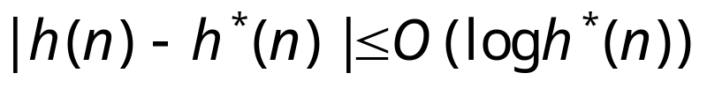
Properties of A*
Complete? Yes
(unless there are infinitely many nodes with f ≤ f(G);
can’t happen if step-cost ≥ ε > 0)
Time/Space? Exponential O(b^{d})
except if:
Optimal? Yes
(with: Tree-Search, admissible heuristic;
Graph-Search, consistent heuristic)
Optimally Efficient? Yes
(no optimal algorithm with same heuristic is guaranteed to expand fewer nodes)

Slide 32
Memory Bounded Heuristic Search: Recursive Best First Search (RBFS)
How can we solve the memory problem for A* search?
Idea: Try something like depth first search, but let’s not forget everything about the branches we have partially explored.
We remember the best f(n) value we have found so far in the branch we are deleting.

Slide 33
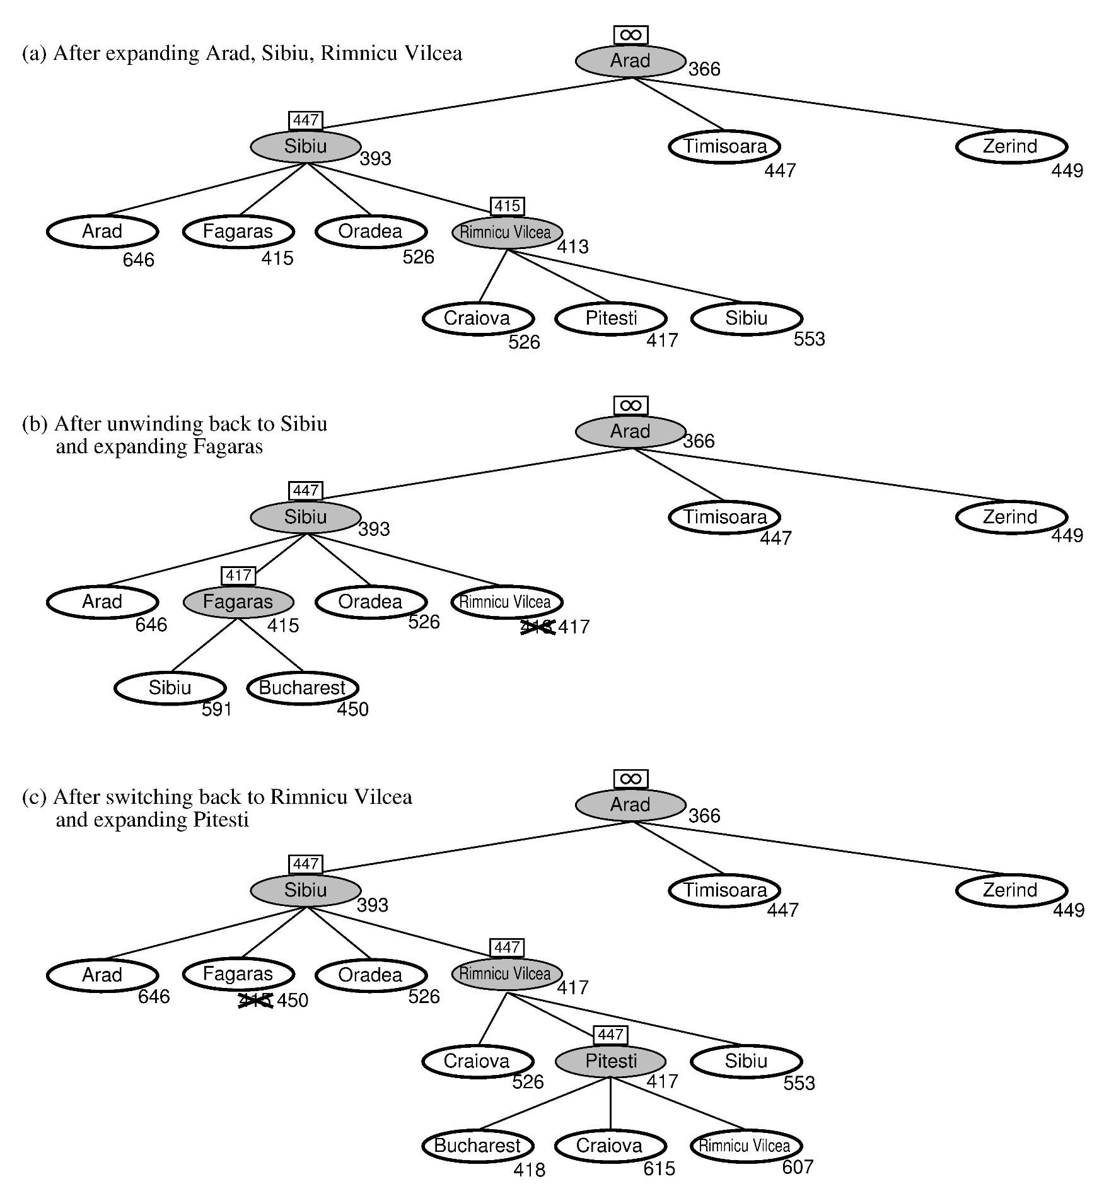
RBFS:
best alternative
over frontier nodes,
which are not children:
i.e. do I want to back up?
RBFS changes its mind
very often in practice.
This is because the
f=g+h become more
accurate (less optimistic)
as we approach the goal.
Hence, higher level nodes
have smaller f-values and
will be explored first.
Problem: We should keep
in memory whatever we can.

Slide 34
Simple Memory Bounded A* (SMA*)
This is like A*, but when memory is full we delete the worst node (largest f-value).
Like RBFS, we remember the best descendent in the branch we delete.
If there is a tie (equal f-values) we delete the oldest nodes first.
simple-MBA* finds the optimal reachable solution given the memory constraint.
Time can still be exponential.
A Solution is not reachable
if a single path from root to goal
does not fit into memory

Slide 35
SMA* pseudocode (not in 2nd edition of R&N)
function SMA*(problem) returns a solution sequence
inputs: problem, a problem
static: Queue, a queue of nodes ordered by f-cost
Queue ← MAKE-QUEUE({MAKE-NODE(INITIAL-STATE[problem])})
loop do
if Queue is empty then return failure
n ← deepest least-f-cost node in Queue
if GOAL-TEST(n) then return success
s ← NEXT-SUCCESSOR(n)
if s is not a goal and is at maximum depth then
f(s) ← ∞
else
f(s) ← MAX(f(n),g(s)+h(s))
if all of n’s successors have been generated then
update n’s f-cost and those of its ancestors if necessary
if SUCCESSORS(n) all in memory then remove n from Queue
if memory is full then
delete shallowest, highest-f-cost node in Queue
remove it from its parent’s successor list
insert its parent on Queue if necessary
insert s in Queue
end

Slide 36
Simple Memory-bounded A* (SMA*)
(Example with 3-node memory)
maximal depth is 3, since
memory limit is 3. This
branch is now useless.
Progress of SMA*. Each node is labeled with its current f-cost. Values in parentheses show the value of the best forgotten descendant.
best forgotten node
Search space
best estimated solution
so far for that node
g+h = f
☐ = goal
A
A
13[15]
0+12=12
A
A
A
10
8
12
12
13
B
G
G
10+5=15
8+5=13
13
10
10
8
16
15
B
B
G
15
13
18
H
C
D
H
I
∞
20+5=25
16+2=18
20+0=20
24+0=24
A
A
A
10
10
8
8
15[15]
15[24]
20[24]
E
F
J
K
A
8
30+5=35
30+0=30
24+0=24
24+5=29
15
B
B
G
15
20[∞]
24[∞]
B
G
I
15
24
C
25
D
24
∞
20
Algorithm can tell you when best solution found within memory constraint is optimal or not.

Slide 37
Memory Bounded A* Search
The Memory Bounded A* Search is the best of the search algorithms we have seen so far. It uses all its memory to avoid double work and uses smart heuristics to first descend into promising branches of the search-tree.
If memory not a problem, then plain A* search is easy to code and performs well.

Slide 38
Heuristic functions
8-puzzle
  Avg. solution cost is about 22 steps
  branching factor ~ 3
  Exhaustive search to depth 22:
    3.1 x 10¹⁰ states.
  A good heuristic function can reduce the search process.
Two commonly used heuristics
  h₁ = the number of misplaced tiles
    h₁(s)=8
  h₂ = the sum of the axis-parallel distances of the tiles from their goal positions (manhattan distance).
    h₂(s)=3+1+2+2+2+3+3+2=18

Slide 39
Dominance
IF h₂(n) ≥ h₁(n) for all n (both admissible)
THEN h₂ dominates h₁
  h₂ is always better for search than h₁
  h₂ guarantees to expand no more nodes than does h₁
  h₂ almost always expands fewer nodes than does h₁
Typical 8-puzzle search costs
(average number of nodes expanded):
  d=12 IDS = 3,644,035 nodes
  A*(h₁) = 227 nodes
  A*(h₂) = 73 nodes
  d=24 IDS = too many nodes
  A*(h₁) = 39,135 nodes
  A*(h₂) = 1,641 nodes

Slide 40
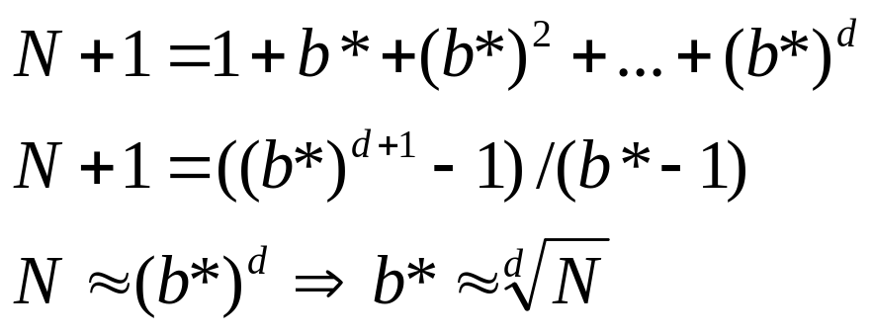
Effective branching factor: b*
Let A* generate N nodes to find a goal at depth d
  b* is the branching factor that a uniform tree of depth d would have in order to contain N+1 nodes.
  For sufficiently hard problems, the measure b* usually is fairly constant across different problem instances.
A good guide to the heuristic’s overall usefulness.
A good way to compare different heuristics.

Slide 41
Effective Branching Factor
Pseudo-code (Binary search)
PROCEDURE EFFBRANCH (START, END, N, D, DELTA)
COMMENT DELTA IS A SMALL POSITIVE NUMBER FOR ACCURACY OF RESULT.
MID := (START + END) / 2.
IF (END - START < DELTA)
THEN RETURN (MID).
TEST := EFFPOLY (MID, D).
IF (TEST < N+1)
THEN RETURN (EFFBRANCH (MID, END, N, D, DELTA) )
ELSE RETURN (EFFBRANCH (START, MID, N, D, DELTA) ).
END EFFBRANCH.
PROCEDURE EFFPOLY (B, D)
ANSWER = 1.
TEMP = 1.
FOR I FROM 1 TO (D-1) DO
TEMP := TEMP * B.
ANSWER := ANSWER + TEMP.
ENDDO.
RETURN (ANSWER).
END EFFPOLY.
For binary search please see: http://en.wikipedia.org/wiki/Binary_search_algorithm
An attractive alternative is to use Newton’s Method (next lecture) to solve for the root (i.e., f(b)=0) of
  f(b) = 1 + b + ... + b^d - (N+1)

Slide 42
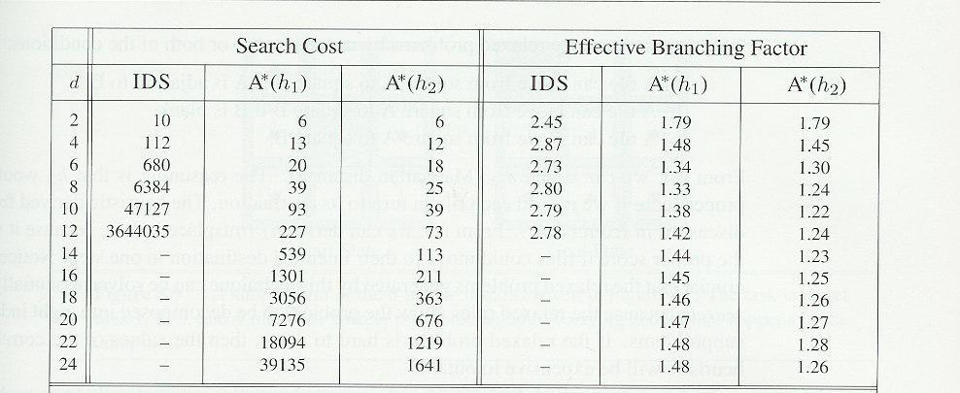
Effectiveness of different heuristics
Results averaged over random instances of the 8-puzzle

Slide 43
Inventing heuristics via “relaxed problems”
A problem with fewer restrictions on the actions is called a relaxed problem
The cost of an optimal solution to a relaxed problem is an admissible heuristic for the original problem
If the rules of the 8-puzzle are relaxed so that a tile can move anywhere, then h₁(n) gives the shortest solution
If the rules are relaxed so that a tile can move to any adjacent square, then h₂(n) gives the shortest solution
Can be a useful way to generate heuristics
  E.g., ABSOLVER (Prieditis, 1993) discovered the first useful heuristic for the Rubik’s cube puzzle

Slide 44
More on heuristics
h(n) = max{ h₁(n), h₂(n), …, h_{k}(n) }
  Assume all h functions are admissible
  E.g., h1(n) = # of misplaced tiles
  E.g., h2(n) = manhattan distance, etc.
  max chooses least optimistic heuristic (most accurate) at each node
h(n) = w₁ h₁ (n) + w₂ h₂(n) + … + w_{k} h_{k}(n)
  A convex combination of features
    Weighted sum of h(n)’s, where weights sum to 1
  Weights learned via repeated puzzle-solving
  Try to identify which features are predictive of path cost

Slide 45
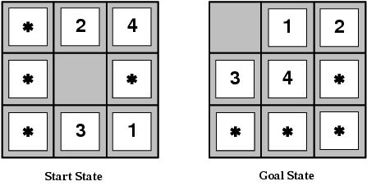
Pattern databases
Admissible heuristics can also be derived from the solution cost of a subproblem of a given problem.
This cost is a lower bound on the cost of the real problem.
Pattern databases store the exact solution to for every possible subproblem instance.
  The complete heuristic is constructed using the patterns in the DB

Slide 46
Summary
Uninformed search methods have uses, also severe limitations
Heuristics are a structured way to add “smarts” to your search
Informed (or heuristic) search uses problem-specific heuristics to improve efficiency
  Best-first, A* (and if needed for memory limits, RBFS, SMA*)
  Techniques for generating heuristics
  A* is optimal with admissible (tree)/consistent (graph) heuristics
Can provide significant speed-ups in practice
  E.g., on 8-puzzle, speed-up is dramatic
  Still have worst-case exponential time complexity
  In AI, “NP-Complete” means “Formally interesting”
Next lecture topic: local search techniques
  Hill-climbing, genetic algorithms, simulated annealing, etc.

